Slide 1
Study Project - II
Advanced Data Mining
(CS G520)
CHESS GAME ANALYSIS & PREDICTION
Name: S Shashank
ID: 2024PHXP0434H

Slide 2
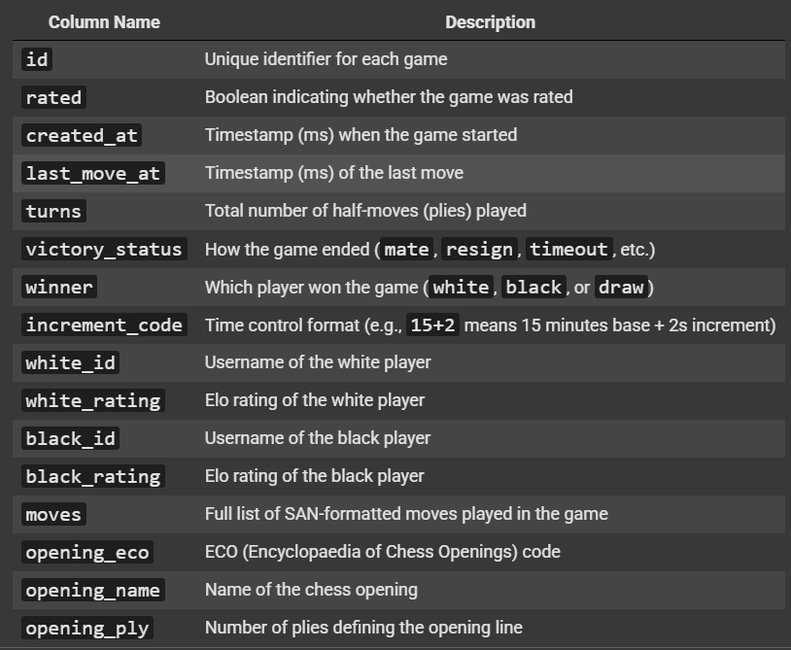

DATASET OVERVIEW
Dataset Title: games.csv
Total Records: 20,058 chess games
Attributes:
Game Metadata
Player Information
Move Data
Opening Strategy

Slide 3
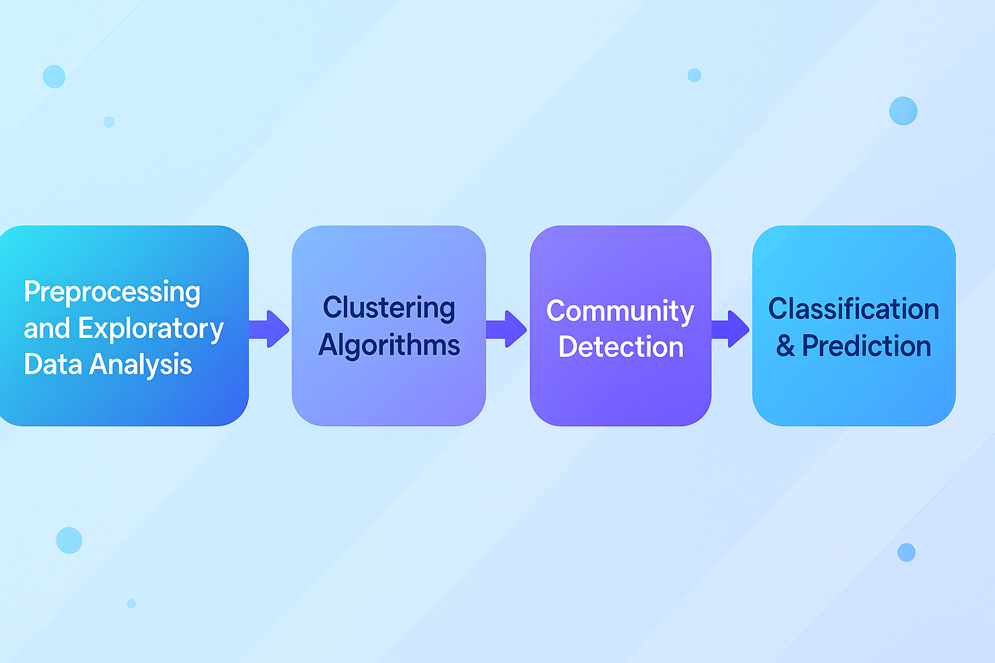
Project Workflow

Slide 4
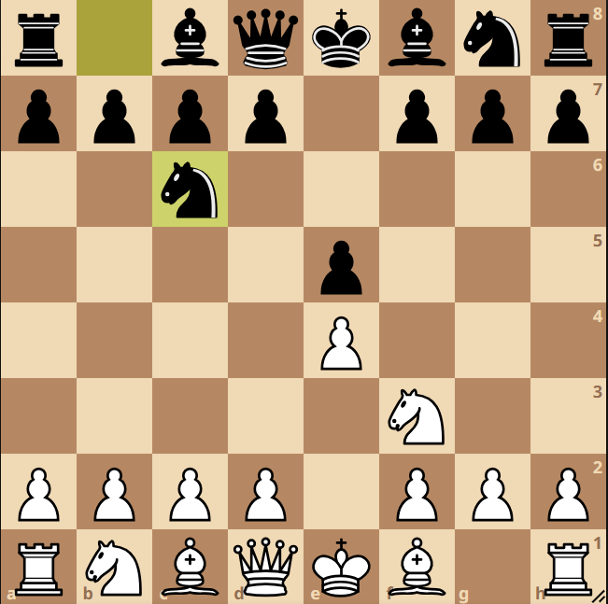
Code Walkthrough

